Slide 1
Graduate Students Wellness
CS700 Seminar CS, Emory University
Happy Mental Health Awareness Week!

Slide 2
Agenda
Grad school: what’s with the bad reputation?
Your experience here: survey results overview
Problems that are common to everyone (and what to do about them)
Problems that may not be as common (and what to do about them)
Strategies and resources

Slide 3
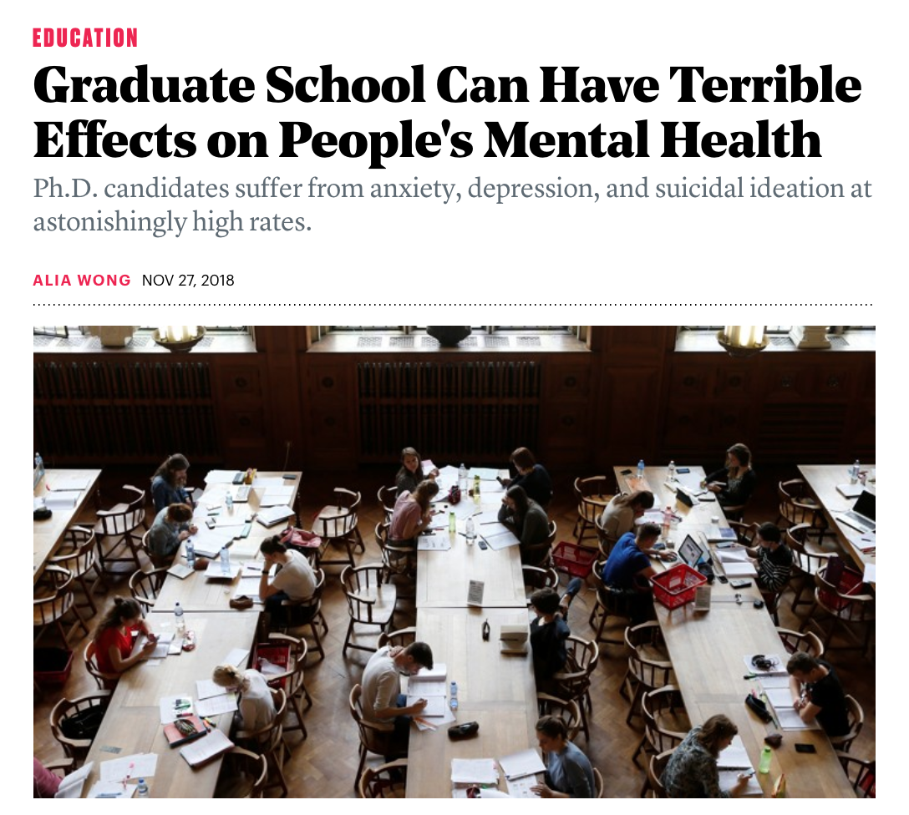
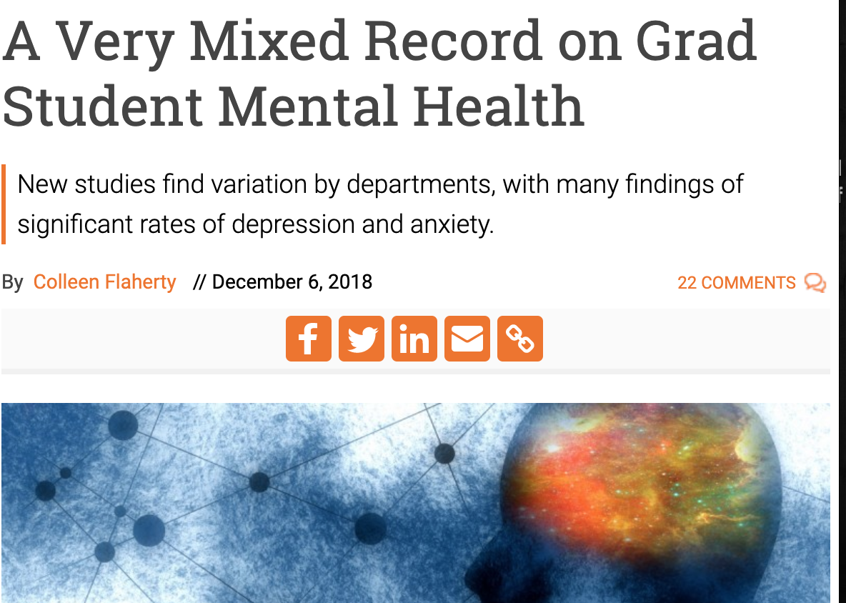
Grad school in the news…

Slide 4
But why? What’s different about grad school?
More prone to isolation and loneliness
Less social interactions than undergrad life (in general)
More prone to Impostor Syndrome
feeling secretly inadequate and out of place
Less-structured nature of research work, with both short- and long-term deadlines
Course work, paper submissions, and also writing a thesis, etc.
Long time-to-completion averages are a serious concern in some places
Possible complex dynamic with supervisor and/or committee
Important to have a healthy relationship with advisor; Important to have mentors!
Financial pressure
Depends on ratio between funding package and cost-of-living
Other life responsibilities (families, kids, etc.)
Y’all are adults now
Notes:
The nature of your work can make you prone to certain risk factors associated with mental health.
Here are some factors.

Slide 5
Department Culture/Climate

Slide 6
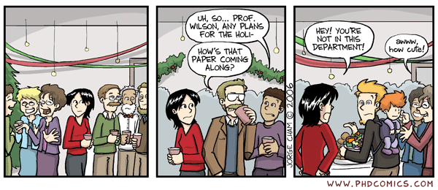
Some background.
Large-scale study surveyed PhD students in eight US universities: Harvard, Columbia, Princeton, Yale, U Michigan, MIT, UC Berkeley, UC SD
Interactions with PhD advisor came up as a significant stress factor
[grad students were] “unable to be honest with their advisers about the challenges they were experiencing.”
fear of making a bad impression; doubts about work; lack of progress.
Poor relationships with peers
[grad students] “who perceive their peers as competitive, who do not have very good friends in the department, and who in general do not have many people with whom they can openly discuss their private feelings without having to hold back, have worse mental health”
https://scholar.harvard.edu/bolotnyy/publications/graduate-student-mental-health-lessons-american-economics-departments

Slide 7
How comfortable are you approaching people in your environment to discuss research problems, ideas, etc.?
<results redacted>

Slide 8
How comfortable are you approaching people in your environment to discuss personal issues?
<results redacted>

Slide 9
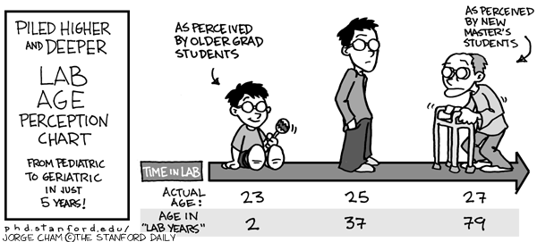
“Department policies are clear and easy to understand”
Let’s break down the data by age

Slide 10
“Department policies are clear and easy to understand”
<results redacted>
≤ 4 semesters
> 4 semesters

Slide 11
“I like the physical workspace assigned to me”
<results redacted>

Slide 12
Wellness and Mental Health Questions

Slide 13
<results redacted>
I have a strong professional support system
I have a strong personal support system

Slide 14
I feel like the majority of people around me are more qualified than me.
[proxy for Impostor Syndrome]
<results redacted>
≤ 4 semesters
> 4 semesters

Slide 15
I feel…
<results redacted>
isolated
demotivated
lost
For those who are experiencing any of these feelings: being proactive and seeking help can go a far away in making you feel better.

Slide 16
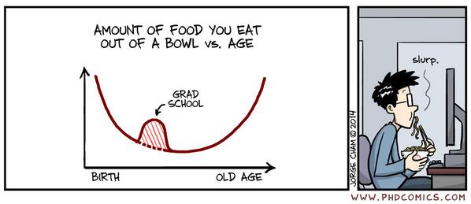
<results redacted>
adequate amounts of sleep
regular exercise
healthy diet

Slide 17
Your perception of factors that are likely to delay your graduation

Slide 18
Factors that are likely to increase length of grad studies: Coursework?
<results redacted>

Slide 19
Factors that are likely to increase length of grad studies: Coursework?
<results redacted>

Slide 20
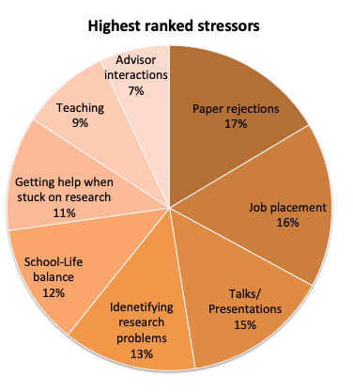
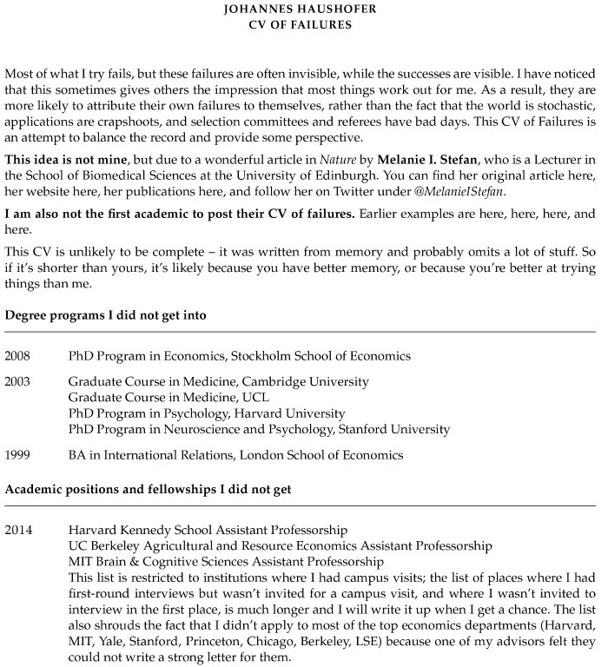
Top grad school stressors [factors you ranked as 4 or 5]

Slide 21
Resources and Recommended Strategies

Slide 22
Emory mental health resources
http://counseling.emory.edu/

Slide 23
8 Wellness Strategies for Graduate Students
Make Time for Downtime
Make sure you treat self-care, socializing, rest, and hobbies just as you do homework assignments and class time. You can't have one without the other!
Don’t forget your physical health
Your physical health has a direct impact on your mental health.
Check in with yourself
Keeping a journal, meeting regularly with friends and practicing meditation as good ways of keeping tabs on your mental health.
Take a social media break
Sometimes the terrible things happening in the world take center stage, and that can wear down even the most mentally-healthy person.
https://www.gograd.org/resources/grad-student-mental-health/

Slide 24
8 Wellness Strategies for Graduate Students
Check in with family or friends
Those who know you outside of academics can offer a unique perspective.
Don’t hesitate to get help
Getting help academically can lessen the mental toll taken by grad school.
Take all medications exactly as directed
If you are prescribed medication to help with mental health issues, take it as directed.
Remember that grad school wont last forever
It's not a sustainable lifestyle, recognizing that it's a limited period of time can help put things in perspective.
https://www.gograd.org/resources/grad-student-mental-health/

Slide 25
Thank you for your insightful comments – your input is valueable.
<results redacted>
Qs:
What can the department do? (policies, procedures, requirements)
What can the university do? (resources, counseling)
What can the students do? (peer support, onboarding, etc)

