Slide 1


Emory Graph Mining Group
KG-LLM Co-learning for Health
Carl Yang @ CS, Emory

Slide 2


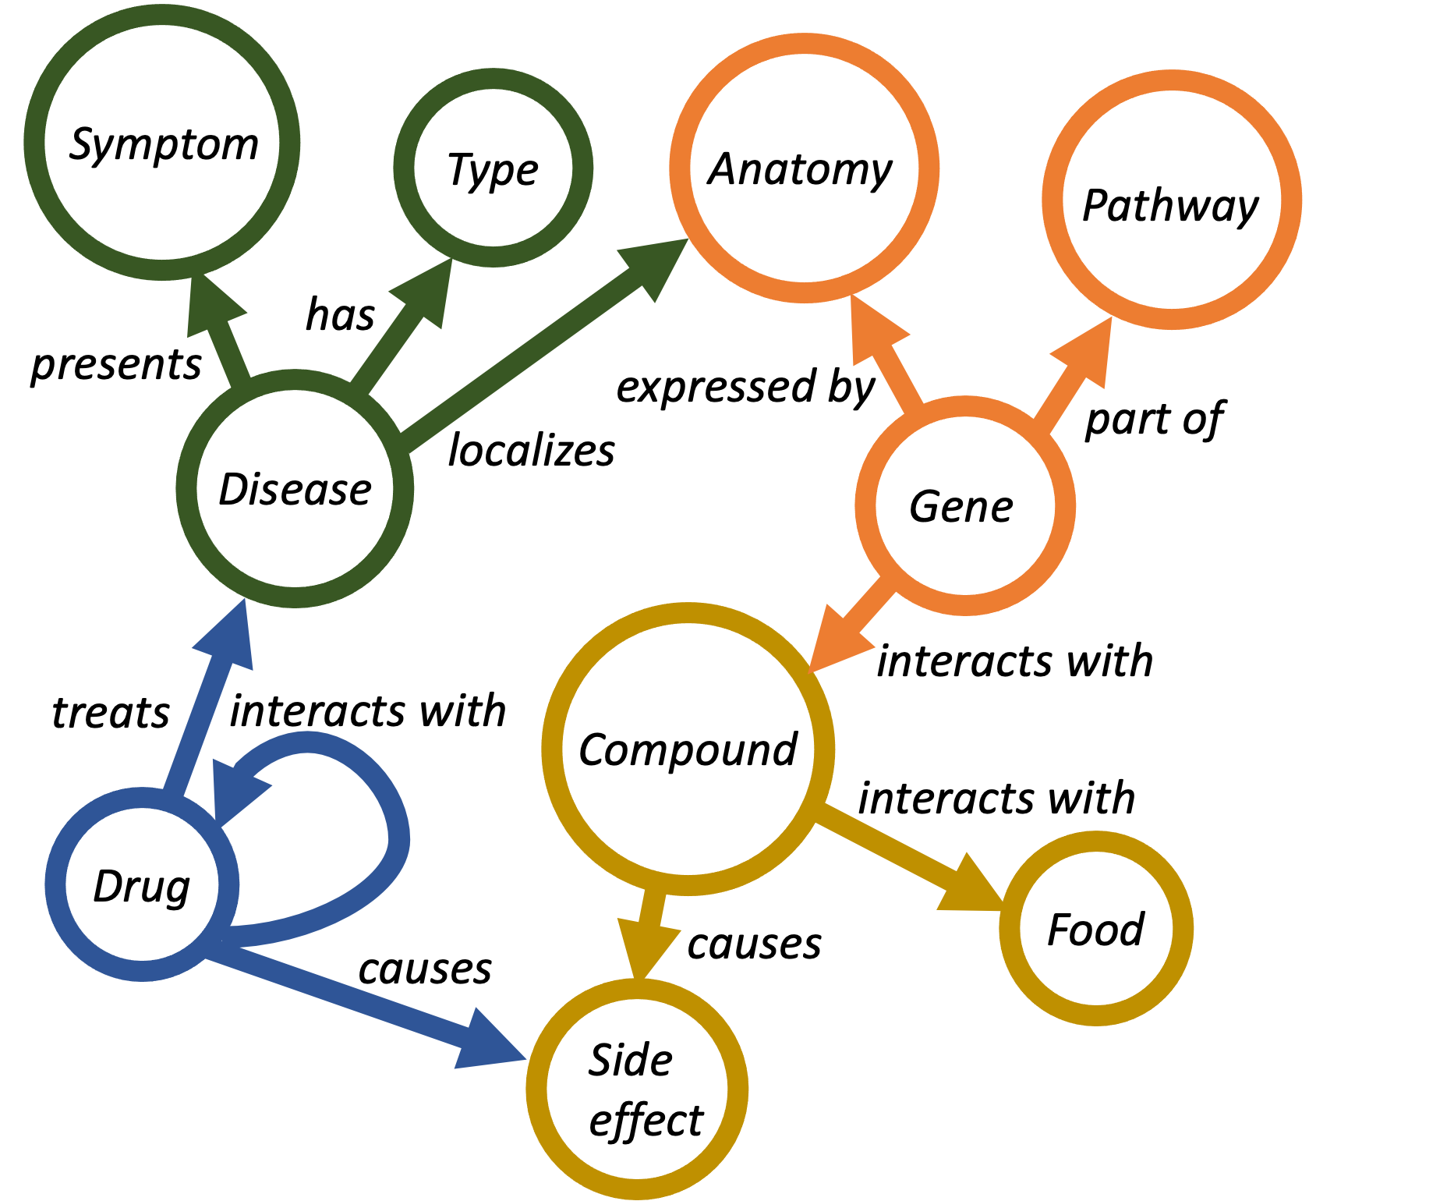
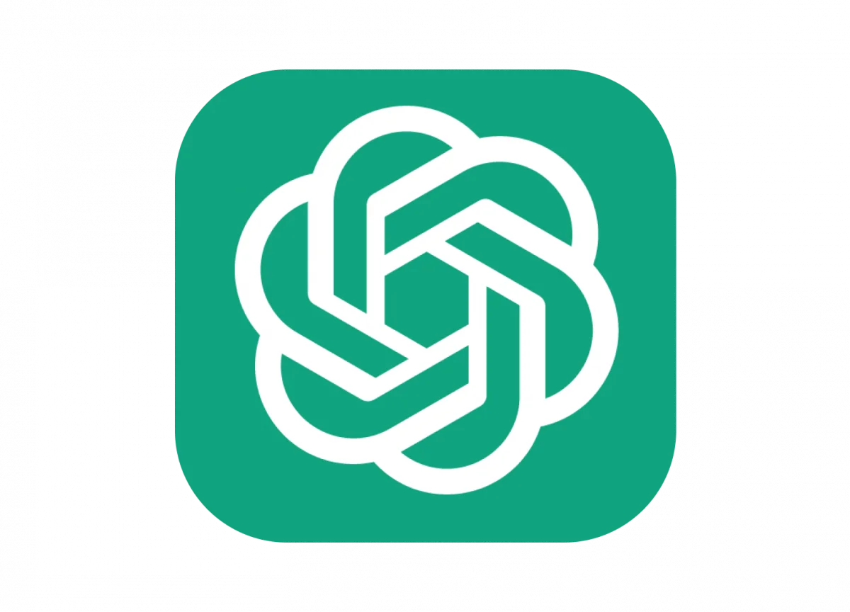








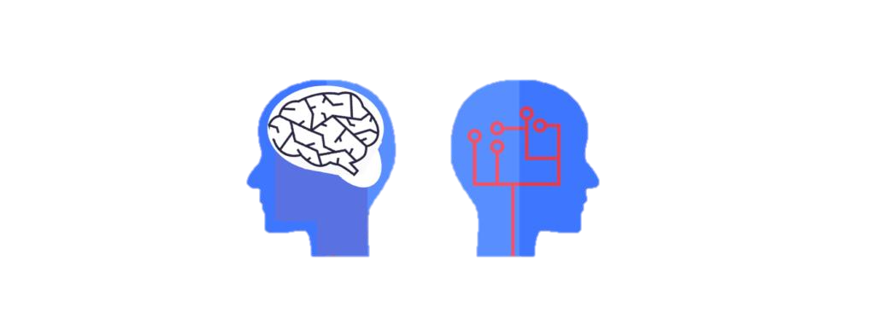



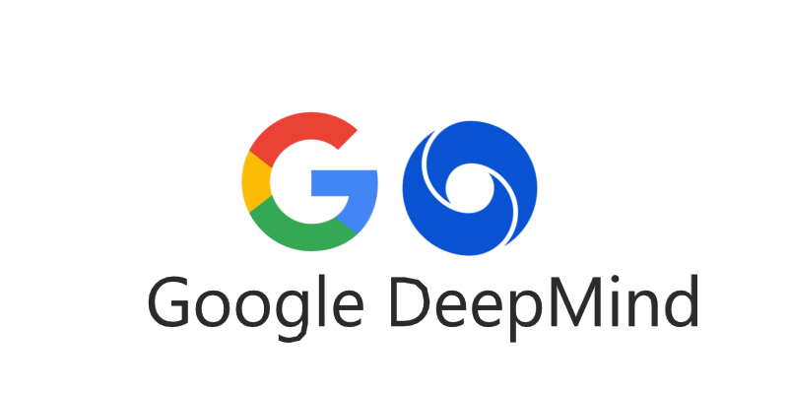
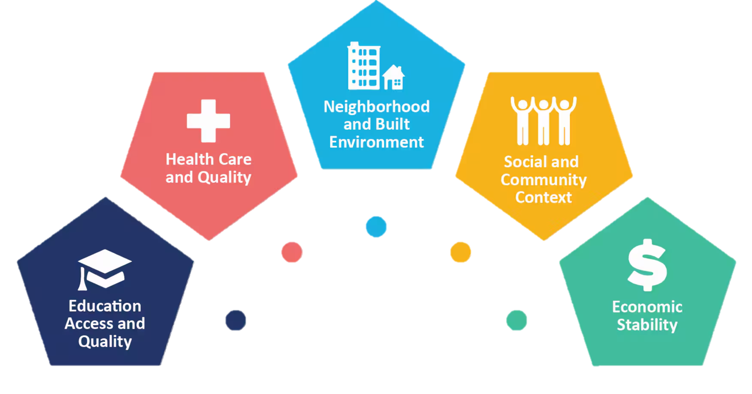

Research Agenda and Vision
Emory Graph Mining Group
Knolwedge graphs
Thrust 1
Large language models
Pros:
Accurate knowledge
Explicit inference
Easy editing
Automatic construction:
Multi-source unification
Continuous improvement
Multi-modal enrichment
Pros:
Broad knowledge
Language comprehension
Generalizability
Cons:
Need standardization
Incomplete knowledge
Gap to application
Thrust 2
Cons:
Lack of planning
Fuzzy inference
Hallucination
Enhancing capabilities:
Guided planning
Rule-based reasoning
Post-hoc grounding
Knowledge-based data sharing
Thrust 3
Conversation-based model collaboration
Human value alignment
Ethical healthcare applications
Health disparity alleviation
Federated multi-agent systems
https://www.cs.emory.edu/~jyang71/files/klc.pdf (IEEE Bulletin’25, Demo at WWW’25, Tutorial at KDD’25)

Slide 3
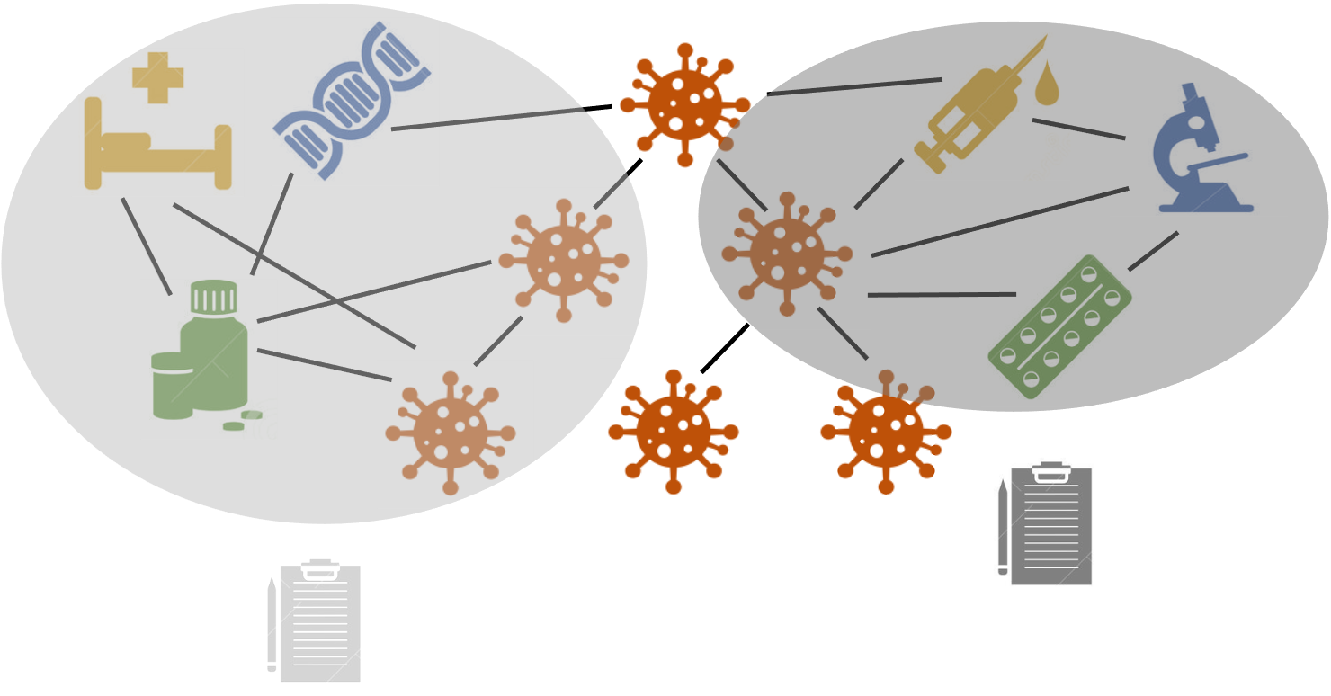
Why Knowledge Graphs
Emory Graph Mining Group
Complex multi-modality multi-source healthcare data
Interconnected risk factors
Accurate factual knowledge and timely update
Rigorous structured reasoning and interpretability

Slide 4
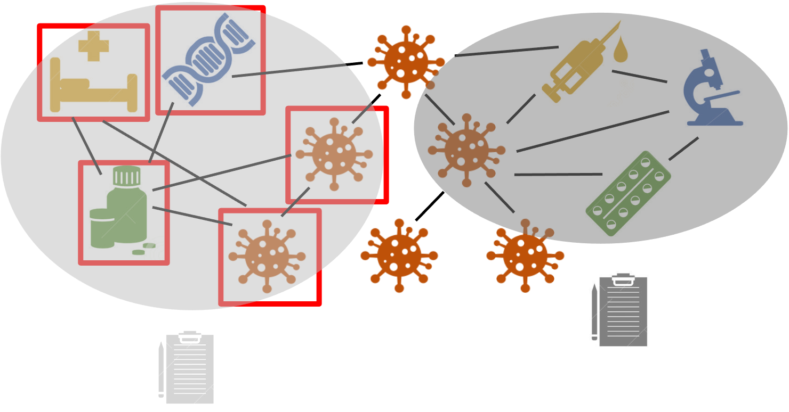
Strengths of KGs for Healthcare: Heterogeneity
Emory Graph Mining Group
Different types of medical concepts and risk factors
Automatic discovery of important meta patterns [ICDM’18, ECML-PKDD’18, ICDM’19]
LLM-empowered human-aided logic reasoning and bootstrapping

Slide 5

Strengths of KGs for Healthcare: Hierarchies
Emory Graph Mining Group
Hierarchical relations
Hierarchical graph construction, alignment, completion [AKBC’22]
Geometric embedding and applications [ICDE’21, ICDE’22]
Ontology-guided knowledge extraction and data integration [SIGIR’23, SIGIR’24]

Slide 6
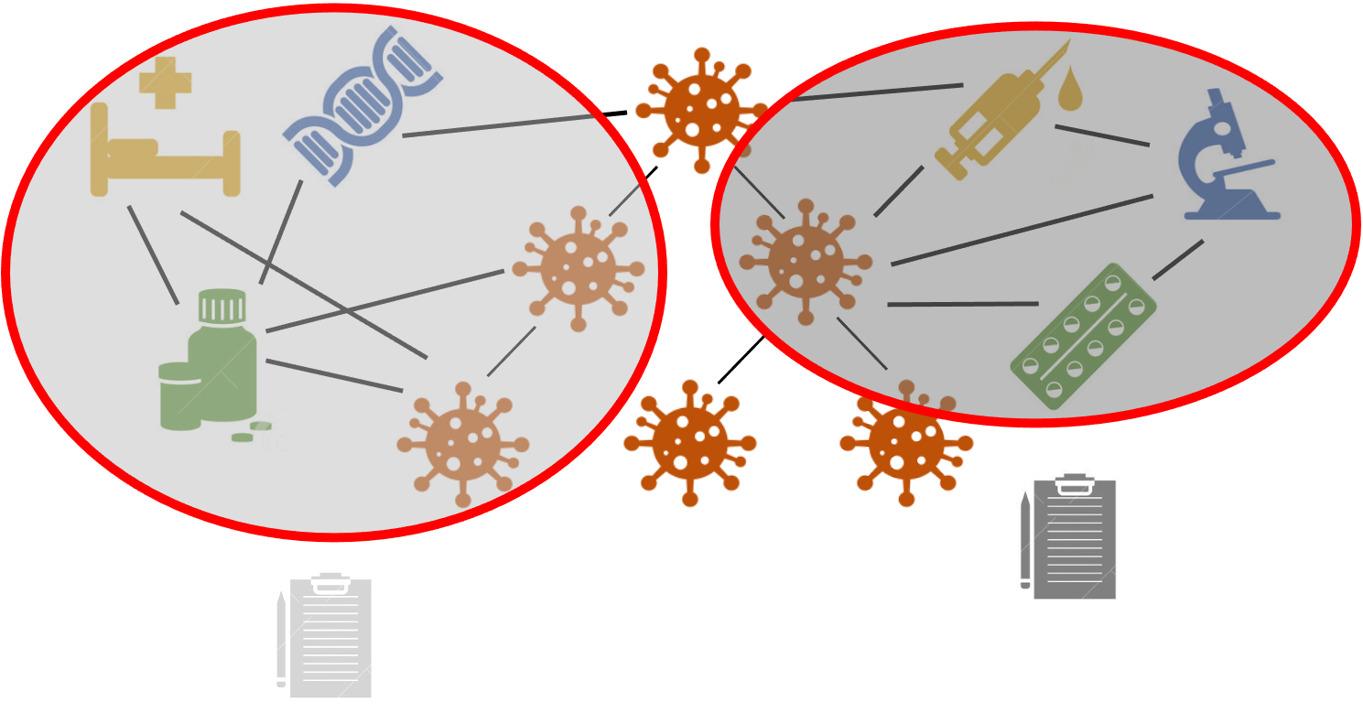
Strengths of KGs for Healthcare: Contextualization
Emory Graph Mining Group
Higher-order interactions and contexts
Counterfactual and factual reasoning [ML4H’22]
LLM-empowered hyper-graph transformers [ACL’24]

Slide 7
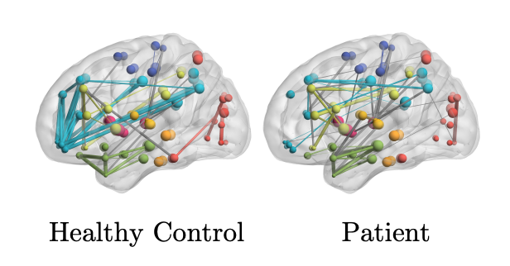
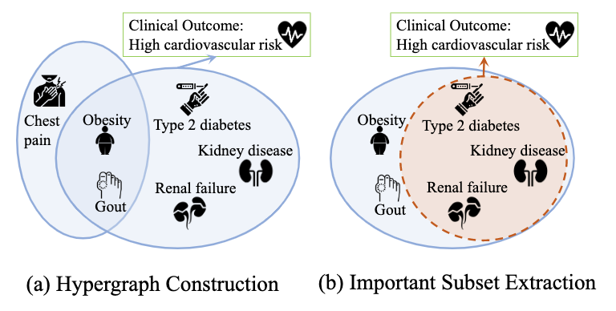
Example Healthcare Applications
Emory Graph Mining Group
Direction 1: Brain network analysis
Benchmark [TMI’22], performance [NeurIPS’22, BHI’24, EMBC’25], interpretation [MICCAI’22, ISBI’23a], structure learning [ISBI’23b, MIDL’22, KDD’22a], multi-view [EMBC’22, BIBM’22], low-resource [NeurIPS’22, KDD’22b, PSB’24, BHI’24]
Direction 2: Multimodality biomedical AI
Heterogeneous clinical data (EHR) [SIGIR’22, KDD’22c]
Molecular (omics), behavioral (survey), environmental (mobility, pollution) [KDD’22d]
Risk prediction, subtyping, treatment analysis, progression [AMIA’23 , ICDM’23, KDD’24, AMIA’24]

Slide 8
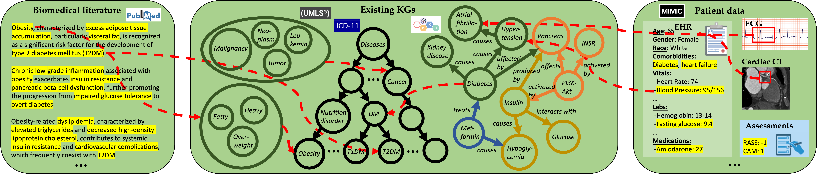
Thrust 1: LLM-Aided KG Construction
Emory Graph Mining Group
Graph extraction from biomedical literature
GT-D2G (TKDE’23)
BMRetriever (EMNLP’24)
LLM-KG+ (submission)
Multi-source knowledge alignment
HiPrompt (SIGIR’23)
PromptLink (SIGIR’24)
Multi-modality knowledge extraction
EHRAgent (EMNLP’24)
GPT-PPG (ClinicalFM’24)
Med-VITAL (NeurIPS’24)

Slide 9




Emory Graph Mining Group
HiPrompt: Few-Shot Biomedical Knowledge Fusion via Hierarchy-Oriented Prompting
Jiaying Lu, Jiaming Shen, Bo Xiong, Wenjing Ma, Steffen Staab, Carl Yang∗
Main contact: j.carlyang@emory.edu

Slide 10



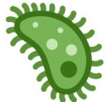
Background: Cross-Platform Graph Alignment
Emory Graph Mining Group
🔬
🤧
🏥 Hospital
🧬
🌿
🤒
🧪
🤕
💊
🦠
🏫 University
🤮
🏛 Institute
7/10/25
Carl Yang [j.carlyang@emory.edu]

Slide 11

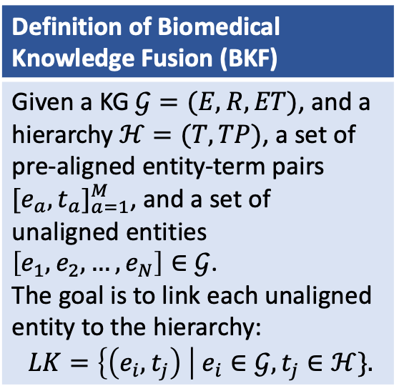
Problem Definition
Emory Graph Mining Group
KG
Hierarchy
Definition of Biomedical Knowledge Fusion (BKF)
Given a KG $𝒢=(E,R,ET)$, and a hierarchy $ℋ=(T,TP)$, a set of pre-aligned entity-term pairs ${[e_{a},t_{a}]}_{a=1}^{M}$, and a set of unaligned entities $\left[e_{1},e_{2},…,e_{N}\right]∈𝒢$. The goal is to link each unaligned entity to the hierarchy: $LK=\left\{\left(e_{i},t_{j}\right) \right| e_{i}∈𝒢,t_{j}∈ℋ\}.$
type-2 diabetes
insulin human
glucose metabolism disease
approvedFor
diabetes mellitus
hyperglycemia
approvedFor
. . .
relatedTo
MODY
. . .
T2D
glucose intolerance
Mason-type diabetes
NDM
relatedTo
. . .
TCF7L2
MODY14
HNF4A
MODY1
drug entity
gene entity
disease entity
disease term
$M≪N$ in BKF!
semantic edge
entity-term alignment
subTypeOf
7/10/25
Carl Yang [j.carlyang@emory.edu]

Slide 12
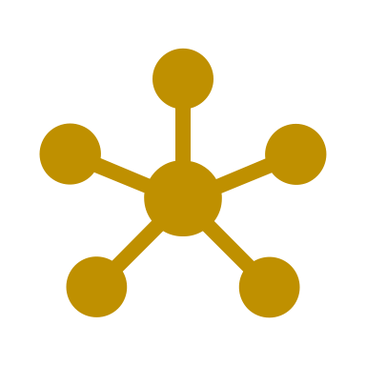



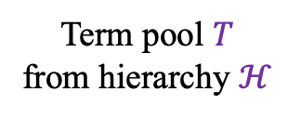

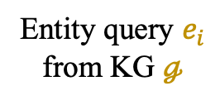


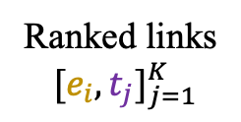

Proposed Framework
Emory Graph Mining Group
Entity query $e_{i}$
from KG $ℊ$
Rank the terms in the choices according to the similarity between them and the entity in the query.
(Task Description)
Query: “NFL”?
Choices: “English Football League”; “National Football League”. Answer: 1.“National Football League”; 2.“English Football League”.
Retriever
BM25 w/ attribute-structure expansion
Re-Ranker
LLM w/ hierarchy context
Top-K
candidates
(Pseudo Demonstration)
$$e_{i}$$
Query: “Prostatic Neoplasms”?
Choices: “prostatic hypertrophy”; “prostate angiosarcoma”; “prostate cancer”.
Contexts: prostatic hypertrophy isA prostate disease. prostate angiosarcoma
isA prostate sarcoma. prostate cancer isA prostate disease. ...
Answer:
Term pool $T$
from hierarchy $ℋ$
Ranked links
$[e_{i},t_{j}]_{j=1}^{K}$
(Test Prompt w/ Hierarchy Context)
1."prostate cancer"; 2."prostate angiosarcoma"; 3."prostatic hypertrophy".
$$t_{1}$$
$$t_{2}$$
$$t_{3}$$
(Response by LLM)
HiPrompt: a few-shot BKF framework via Hierarchy-Oriented Prompting
We formulate the BKF problem as a ranking problem, and utilize the classic retrieve and re-rank approach
unsupervised Retriever
few-shot Re-Ranker
7/10/25
Carl Yang [j.carlyang@emory.edu]

Slide 13
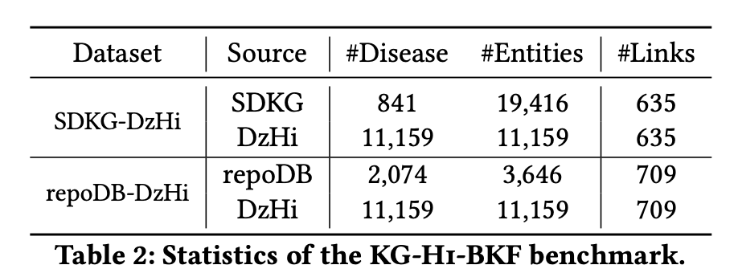
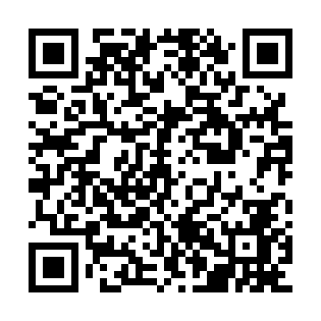
Benchmark Datasets
Emory Graph Mining Group
Scan to download
7/10/25
Carl Yang [j.carlyang@emory.edu]

Slide 14
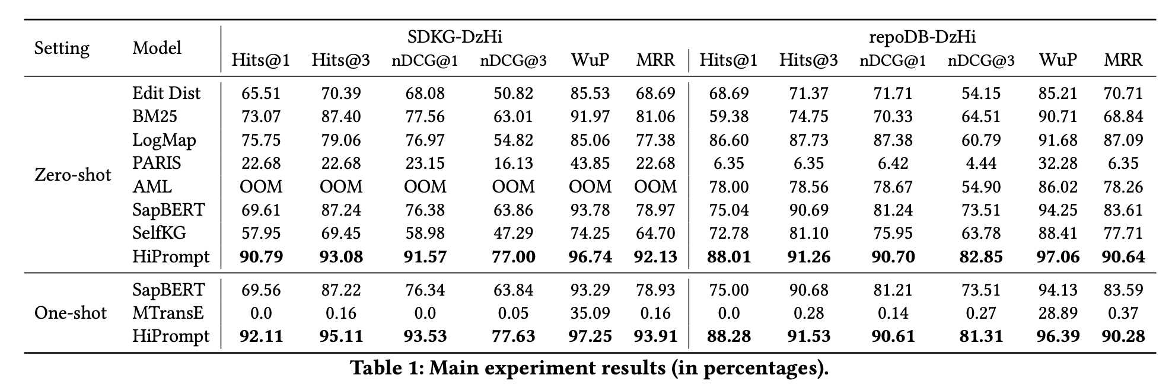
Main Experimental Results
Emory Graph Mining Group
7/10/25
Carl Yang [j.carlyang@emory.edu]

Slide 15
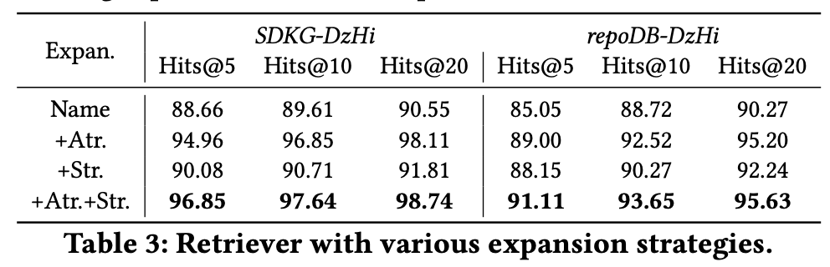
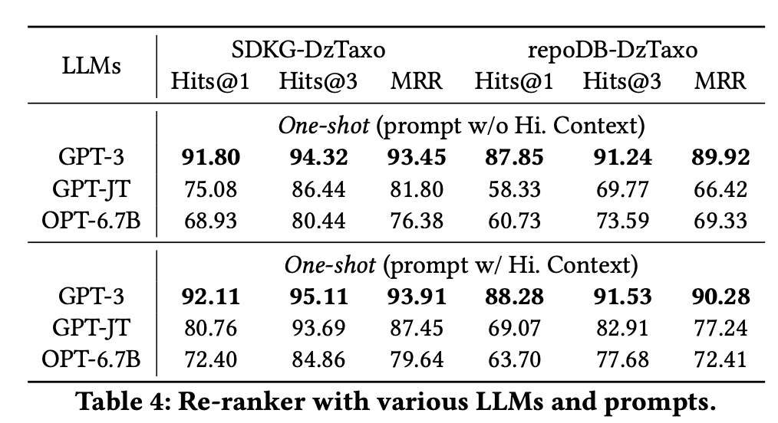
Ablation Studies
Emory Graph Mining Group
7/10/25
Carl Yang [j.carlyang@emory.edu]

Slide 16
Case Studies
Emory Graph Mining Group
SDKG-DzHi
disease of anatomical entity
disease
syndrome
. . .
disease of anatomical entity
Query
. . .
. . .
Query
immune system disease
immune suppression
short stature-obesity syndrome
short
syndrome
anuria
brain compression
short bowel syndrome
repoDB-DzHi
anthrax disease
disease
disease of metabolism
disease by infectious agent
Query
Query
. . .
. . .
inhalational anthrax
inhalation anthrax
injection anthrax
typhus, epidemic Louse-Borne
epidemic typhus
disease entity
disease term
subTypeOf
endemic goiter
Brill-Zinsser disease
HiPrompt
BM25
EditDist
7/10/25
Carl Yang [j.carlyang@emory.edu]

Slide 17
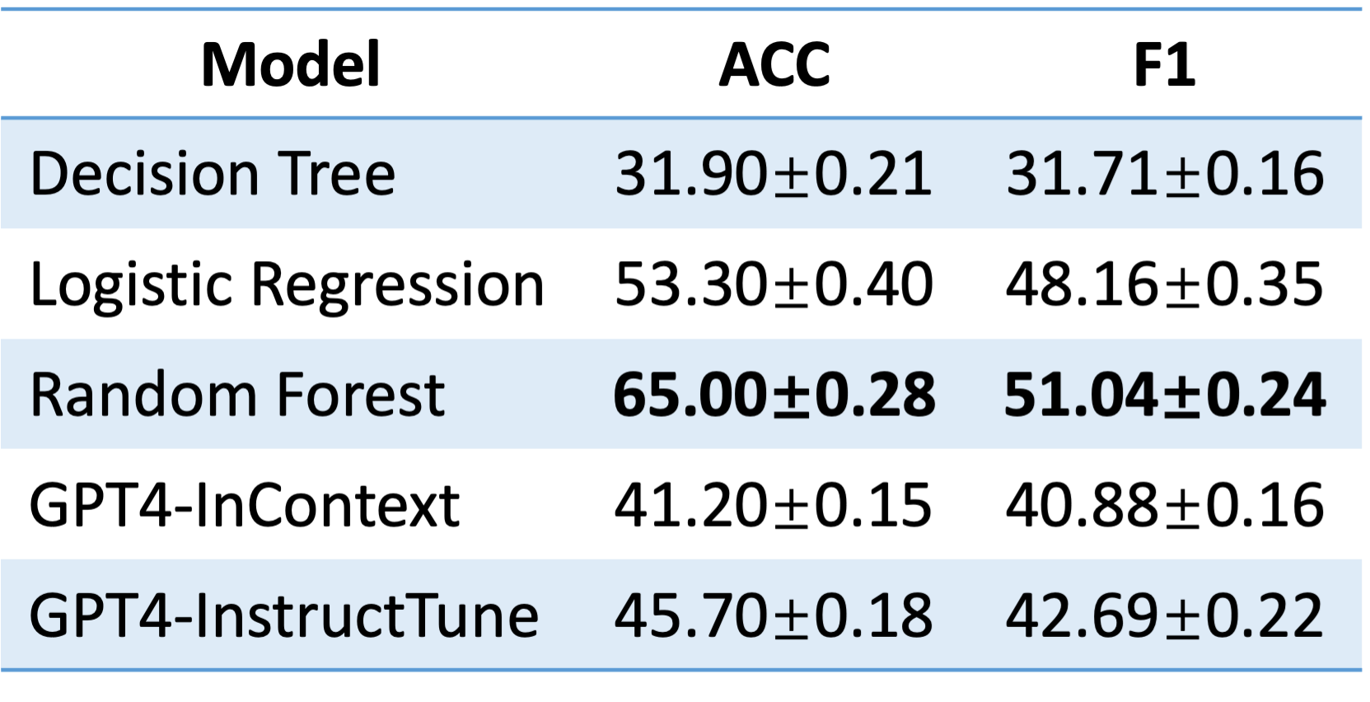
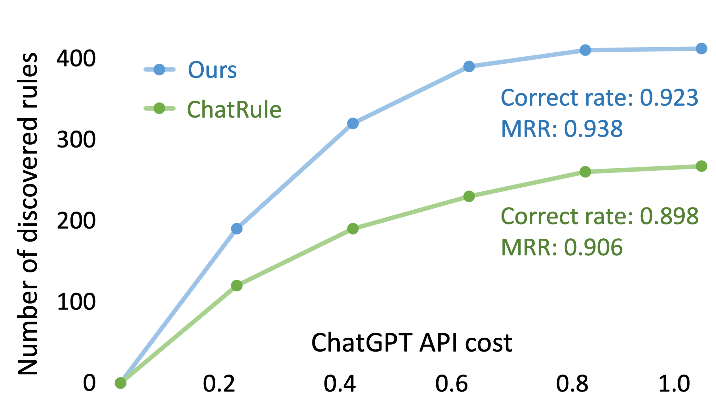
Thrust 2: KG-Guided LLM Enhancement
Emory Graph Mining Group
Providing biomedical knowledge to enhance planning
EHR-Critique (AMIA’24)
RAM-EHR (ACL’24)
MedAdapter (EMNLP’24)
SimRAG (NAACL’24)
Onto-Plan (AMIA’25)
Enabling neural symbolic rule learning to enhance reasoning
WalkLM (NeurIPS’23)
MuseGraph (TPAMI’25)
LLM-rule (submission)
LLM-cause (KDD’25)
Enforcing post-hoc error detection to enhance grounding
DDX-retro (npj Digital Medicine’25)

Slide 18


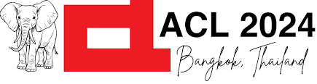
Emory Graph Mining Group
RAM-EHR: Retrieval Augmentation Meets Clinical Predictions on Electronic Health Records
Ran Xu, Wenqi Shi, Yue Yu, Yuchen Zhuang, Bowen Jin, May Wang, Joyce Ho, Carl Yang∗
Main contact: j.carlyang@emory.edu

Slide 19
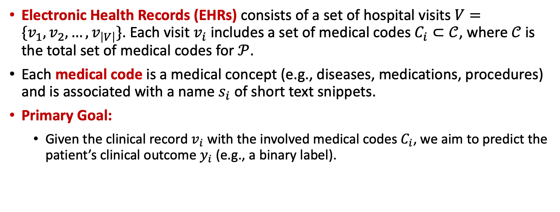
Introduction & Problem Setup
Emory Graph Mining Group
Electronic Health Records (EHRs) consists of a set of hospital visits $V=\{v_{1},v_{2},…,v_{\left|V\right|}\}$. Each visit $v_{i}$ includes a set of medical codes $C_{i}⊂𝒞$, where $𝒞$ is the total set of medical codes for $𝒫$.
Each medical code is a medical concept (e.g., diseases, medications, procedures) and is associated with a name $s_{i}$ of short text snippets.
Primary Goal:
Given the clinical record $v_{i}$ with the involved medical codes $C_{i}$, we aim to predict the patient’s clinical outcome $y_{i}$ (e.g., a binary label).
19 / 30

Slide 20
Challenges
Emory Graph Mining Group
Many works leverage external knowledge for better downstream performance
Knowledge from knowledge graphs (KGs)
They mostly rely on knowledge from a single source and mainly focus on specific types of relations (e.g., hierarchical relations)
It is non-trivial to align medical codes in EHRs with KGs due to the non-uniformity of surface names (e.g., abbreviations or colloquial terms)
Knowledge generated by large language models (LLMs)
LLMs may not always provide the most relevant knowledge for target tasks
Face the risk of hallucination
20 / 30

Slide 21
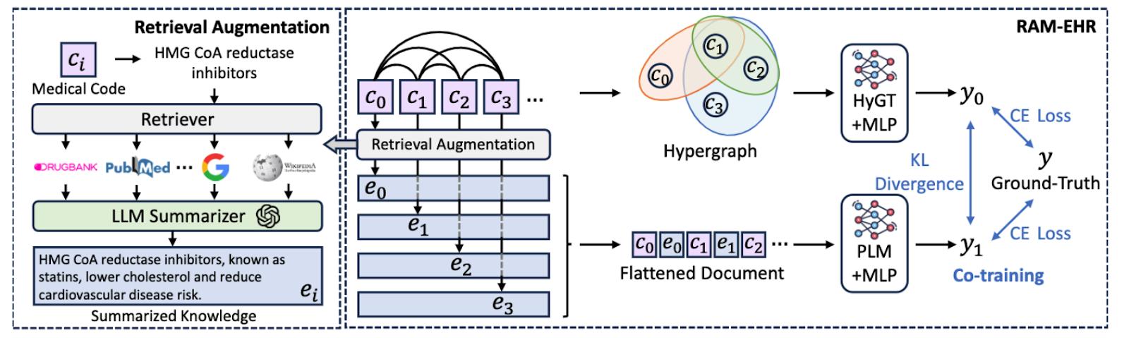
In this work
Emory Graph Mining Group
We propose RAM-EHR, a retrieval-augmented framework tailored for clinical predictive tasks on EHRs
We collect multiple knowledge sources (e.g., KGs, scientific literature) and leverage dense retrieval (DR) to capture the semantics of medical codes
We utilize an LLM to summarize the top-retrieved passages into concise and informative knowledge summaries relevant to downstream tasks
We co-train the local model and the augmented model with a consistency regularization.
21 / 30

Slide 22
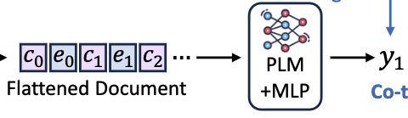
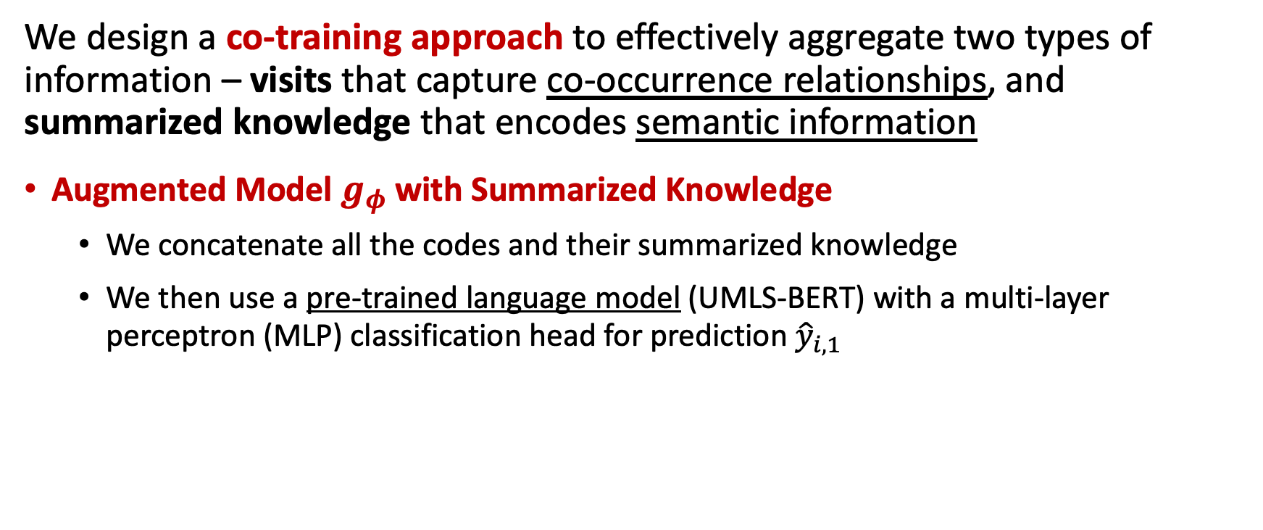
Augmenting Patient Visits with Summarized Knowledge via Co-training
Emory Graph Mining Group
We design a co-training approach to effectively aggregate two types of information – visits that capture co-occurrence relationships, and summarized knowledge that encodes semantic information
Augmented Model $g_{φ}$ with Summarized Knowledge
We concatenate all the codes and their summarized knowledge
We then use a pre-trained language model (UMLS-BERT) with a multi-layer perceptron (MLP) classification head for prediction ${\hat{y}}_{i,1}$
22 / 30

Slide 23
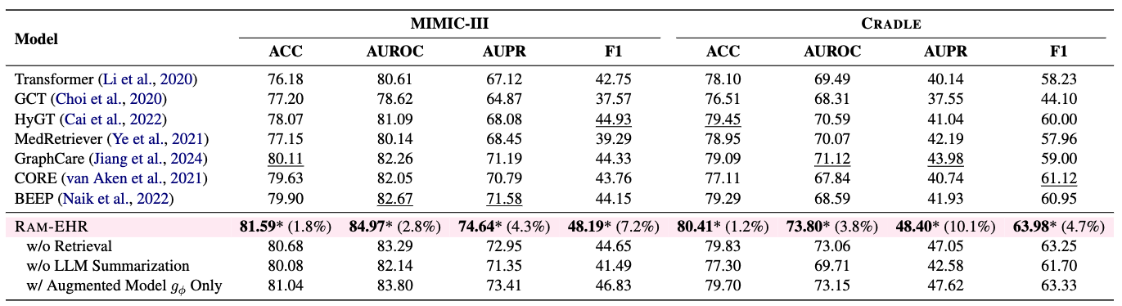
Main Experimental Results
Emory Graph Mining Group
MIMIC-III: 25-label phenotypes prediction for the next visit (25-label binary classification)
CRADLE: cardiovascular disease (CVD) endpoints prediction task for diabetes patients (binary classification)
23 / 30

Slide 24
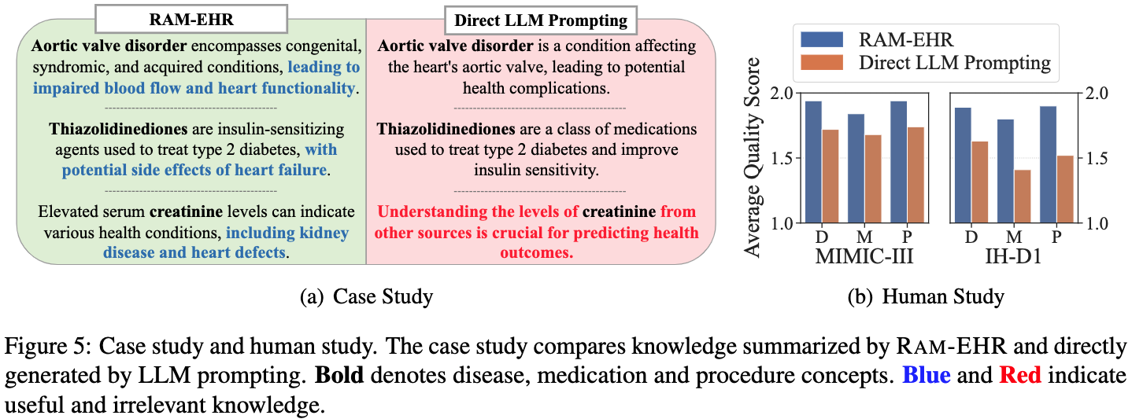
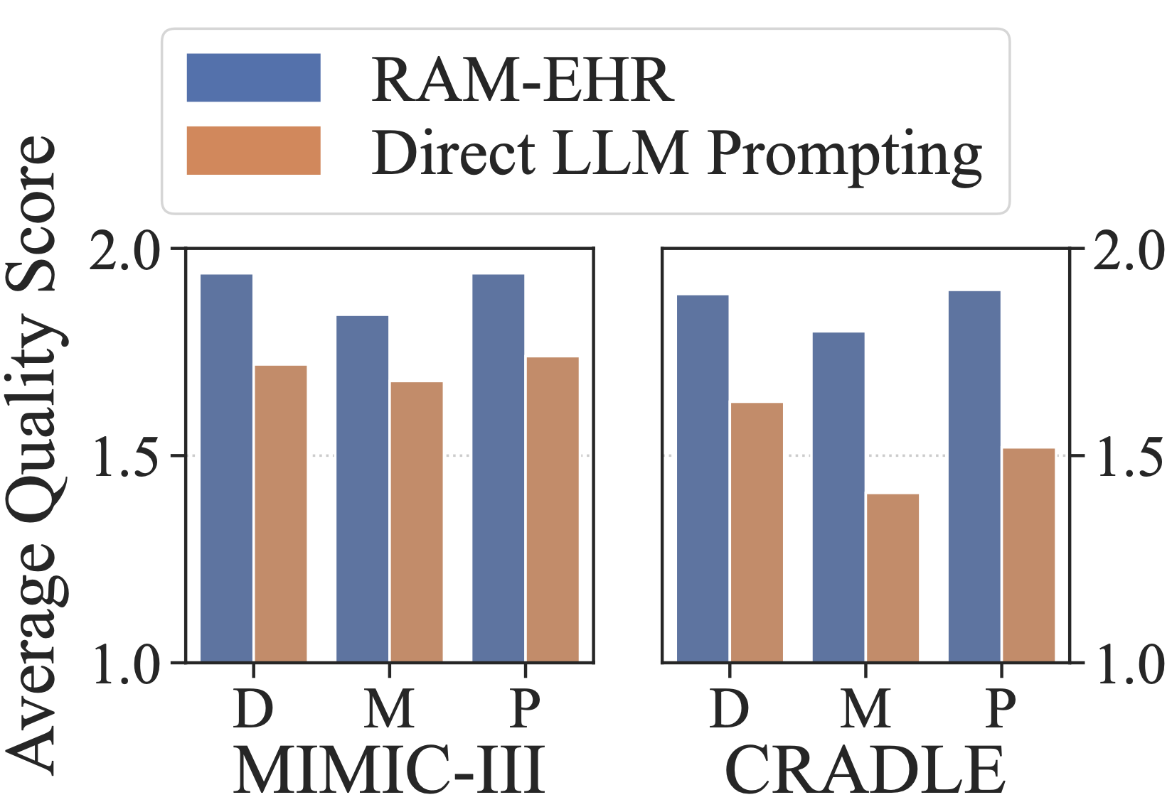
Case Study and Human Study
Emory Graph Mining Group

Slide 25
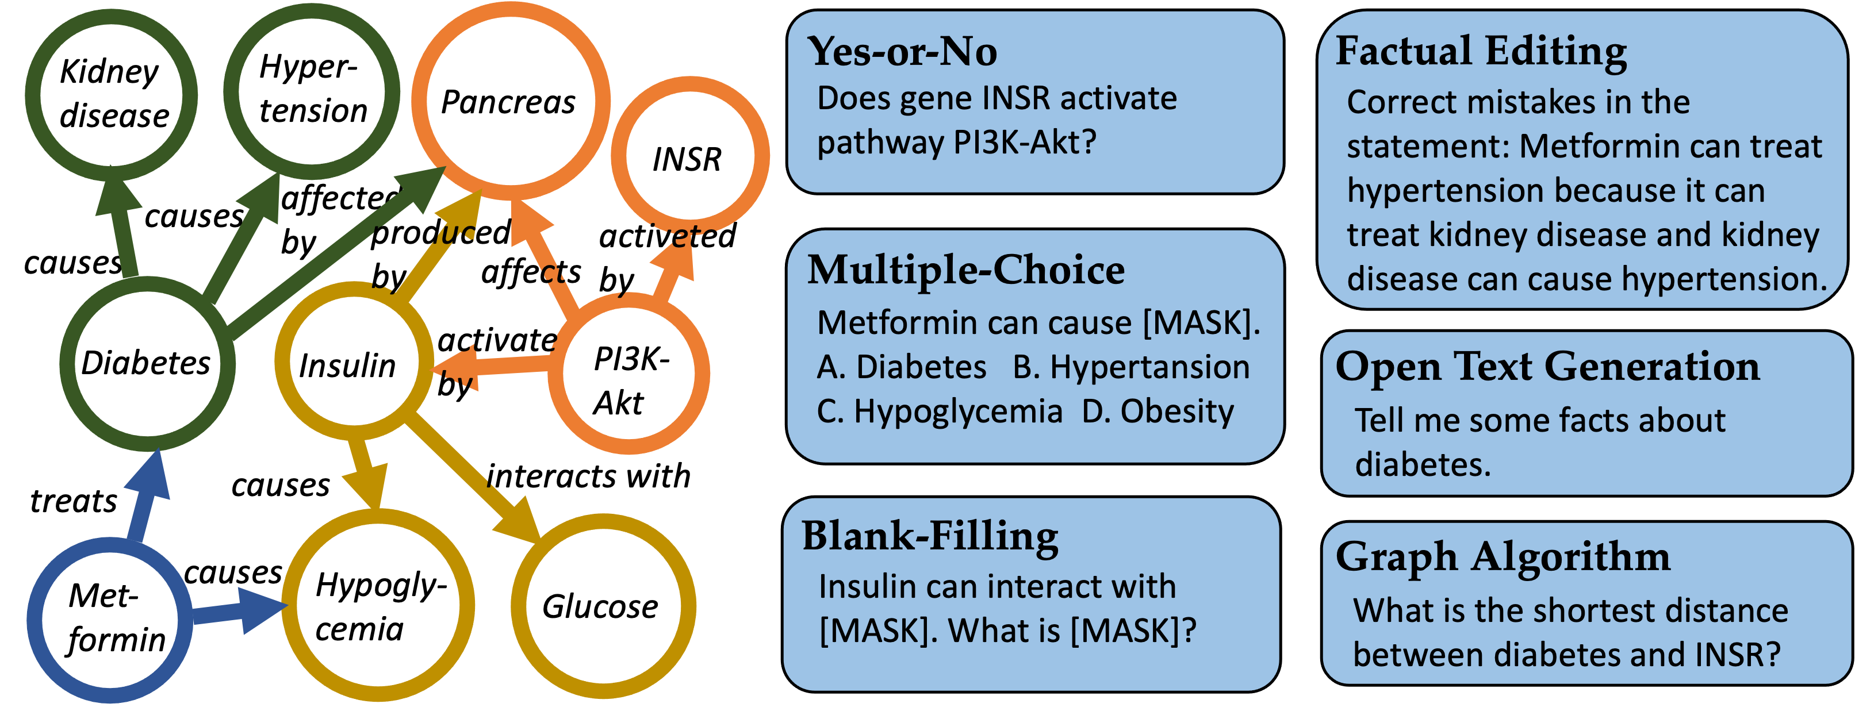
Thrust 2’: KG-Guided LLM Evaluations
Emory Graph Mining Group
Hallucination detection
Misinformation detection

Slide 26
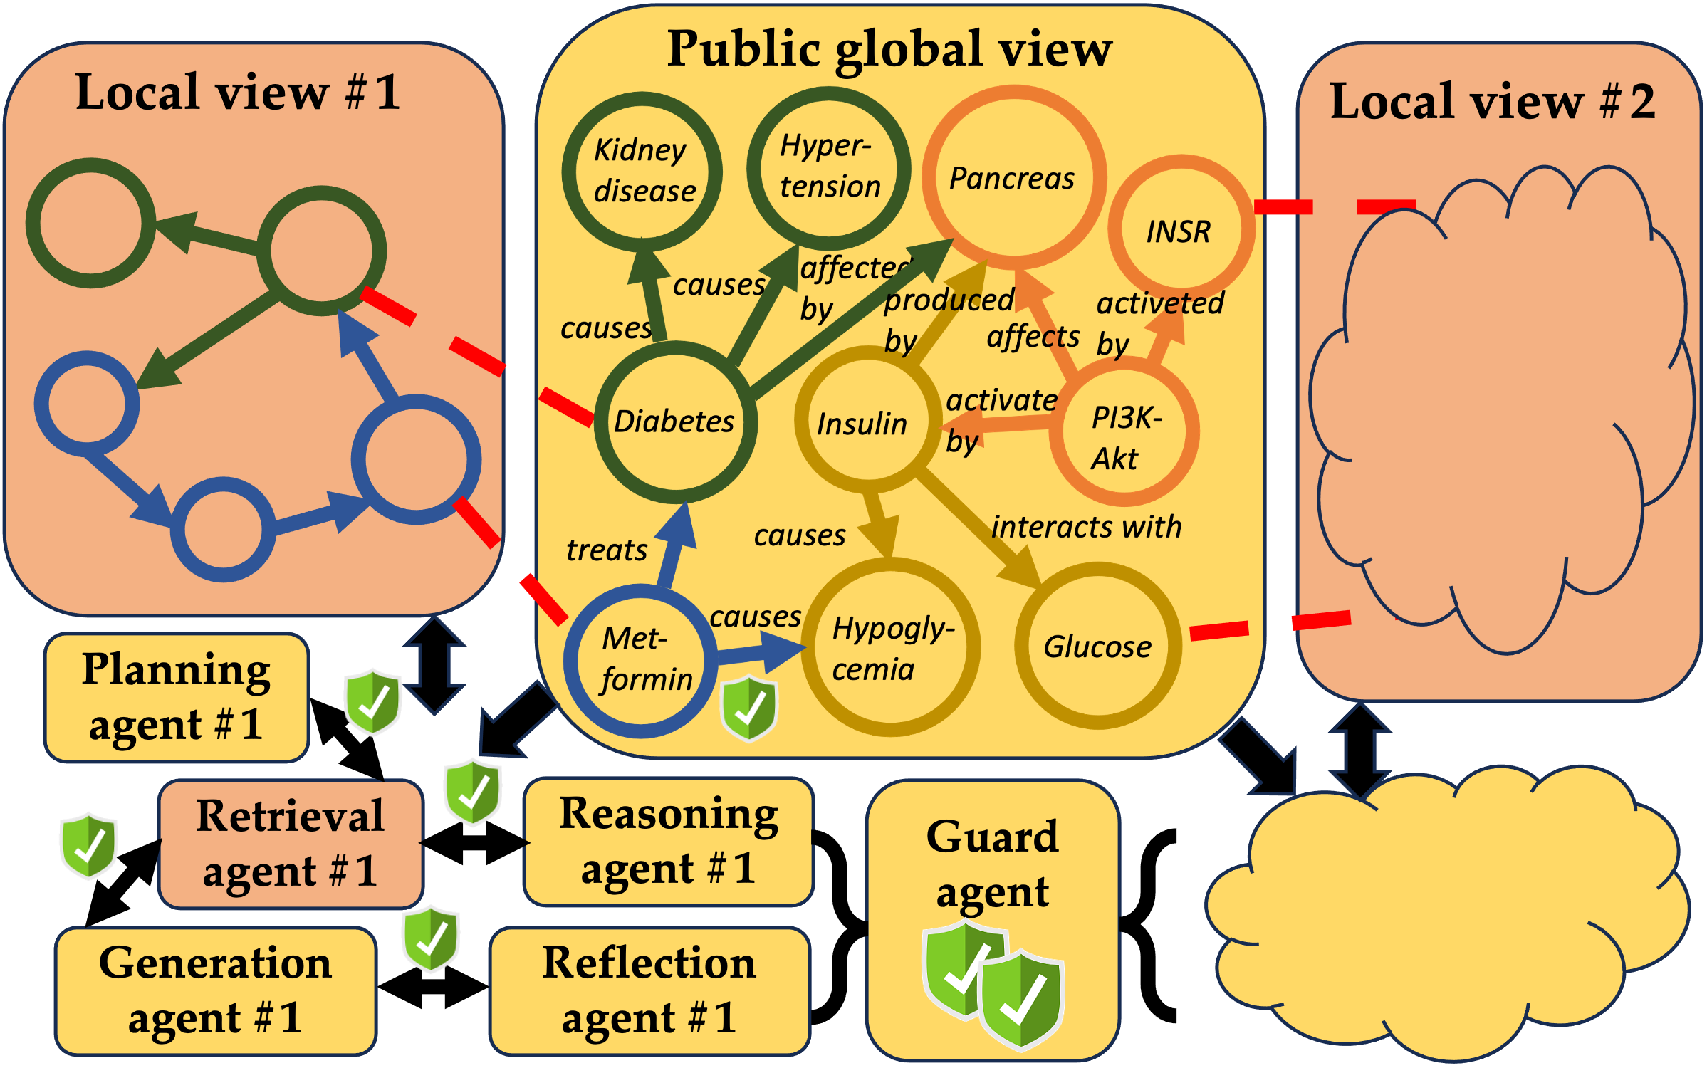
Thrust 3: Federated Multi-agent System
Emory Graph Mining Group
Federated learning
FedSage (NeurIPS’21), GCFL (NeurIPS’21), FedDEP (SDM’23), FedDA (ICDE’23), FedLIT (WWW’23), FedGrAINS (SDM’24), FedLoG (ICLR’25)
Secret sharing
DPGGen (IJCAI’21), FedR (EMNLP-F’22), FedScem (CIKM’24), GuardAgent (ICML’25)

Slide 27
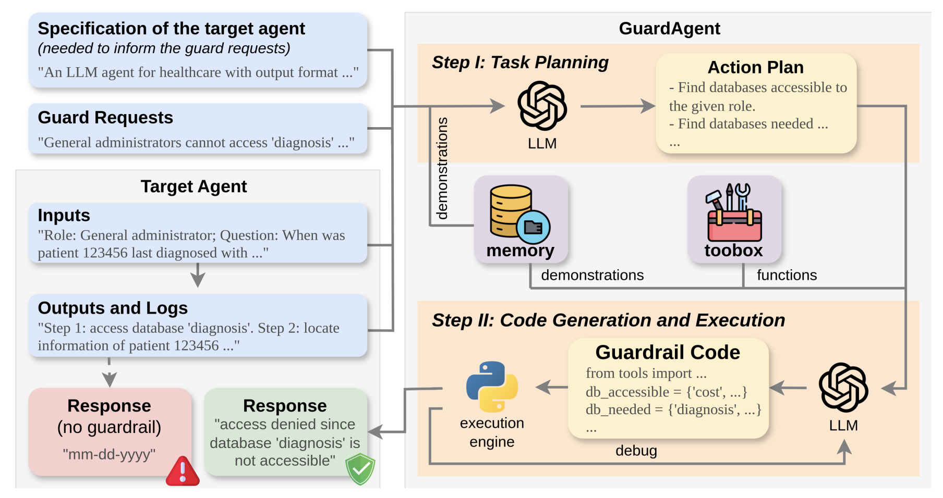
Key Component: GuardAgent
Emory Graph Mining Group
Input:
Guard requests
Test-time input/output
Procedure:
Action plan generation
Guardrail code generation
Violation detection

Slide 28
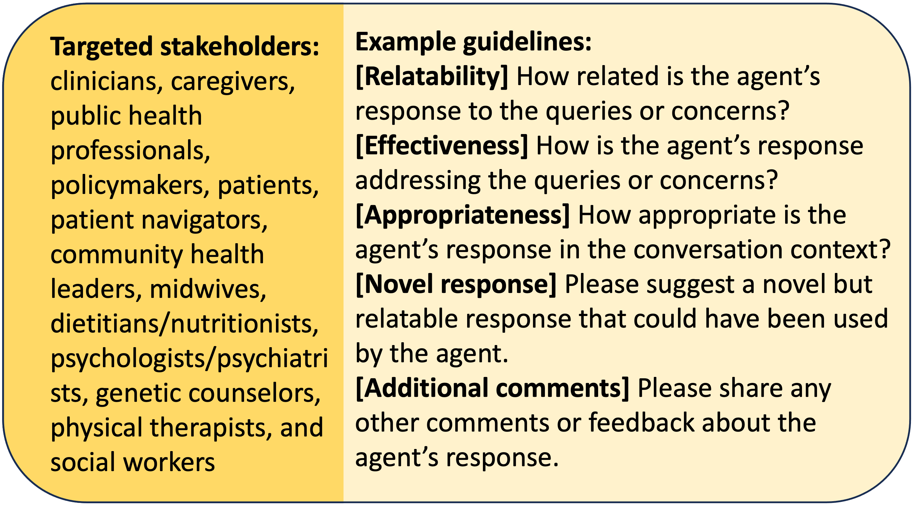
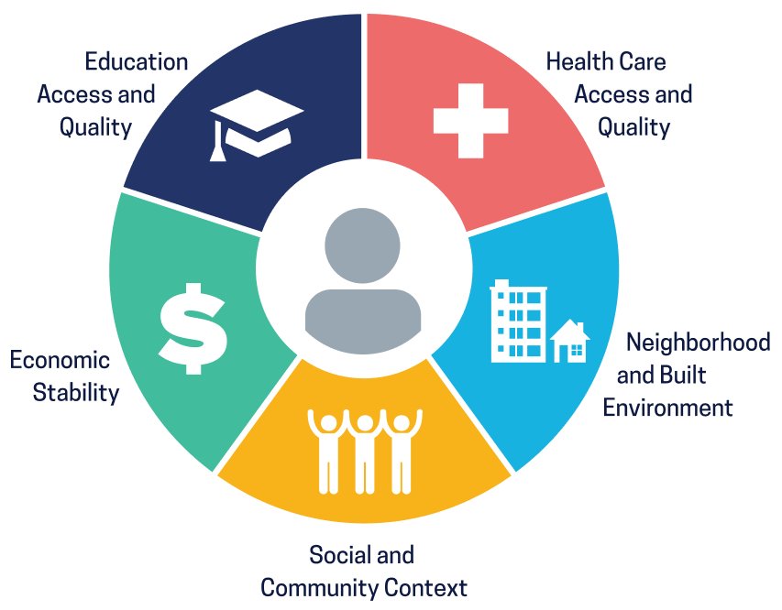
Thrust 3’: Human-involved FedMaS
Emory Graph Mining Group

Slide 29

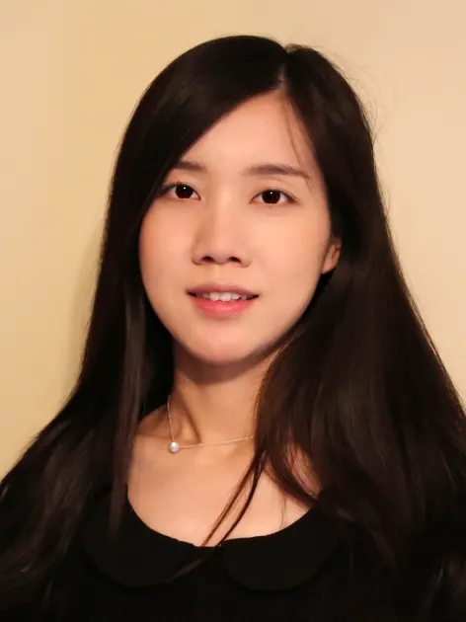
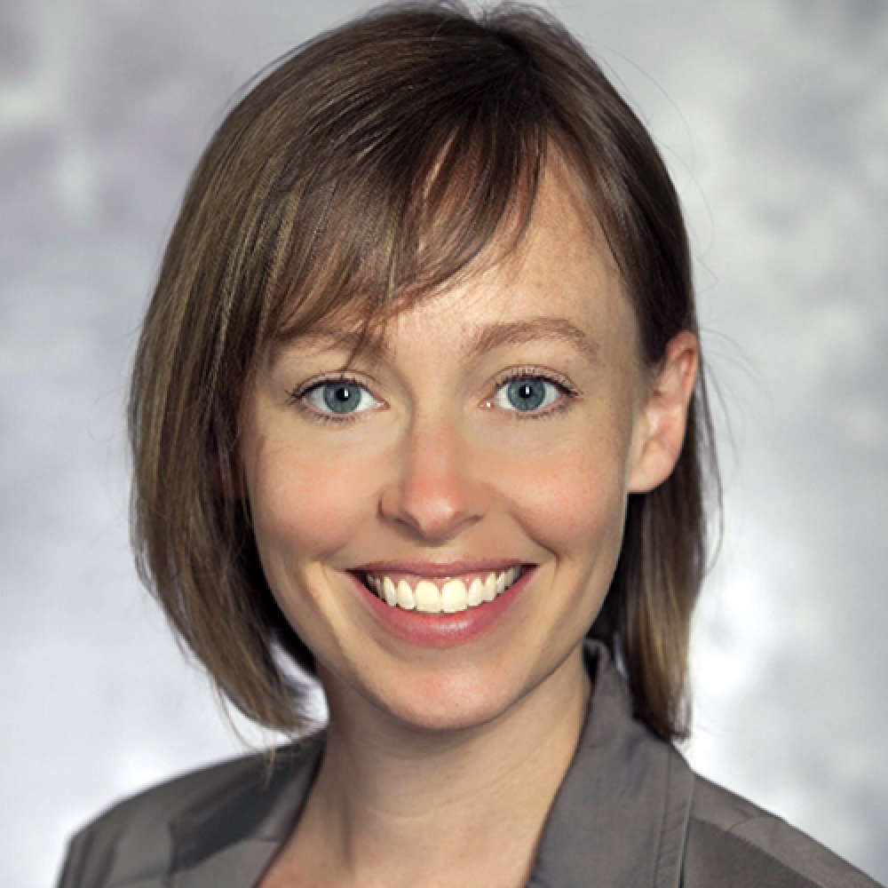
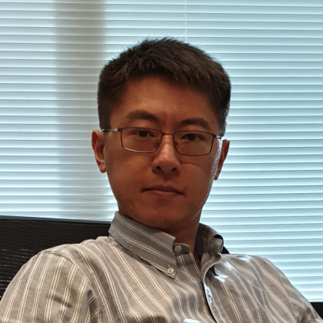
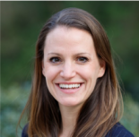

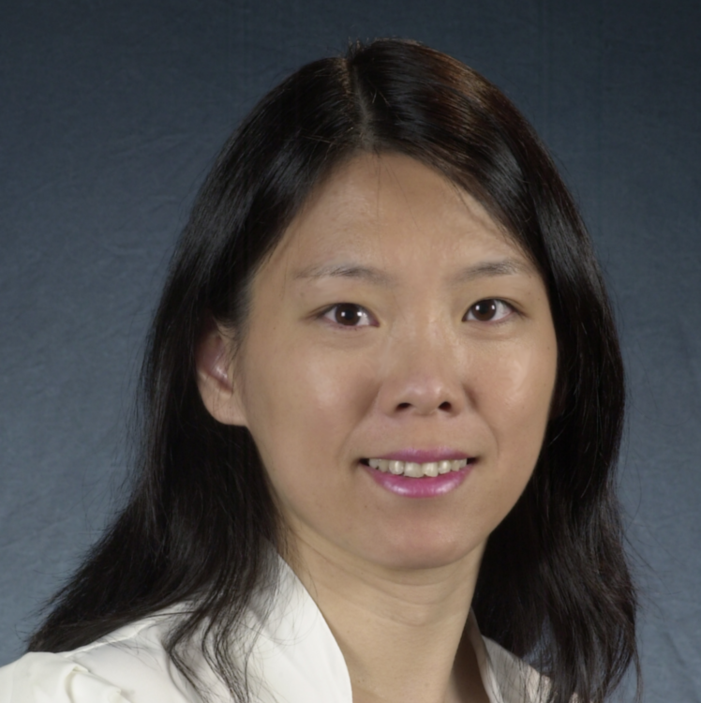
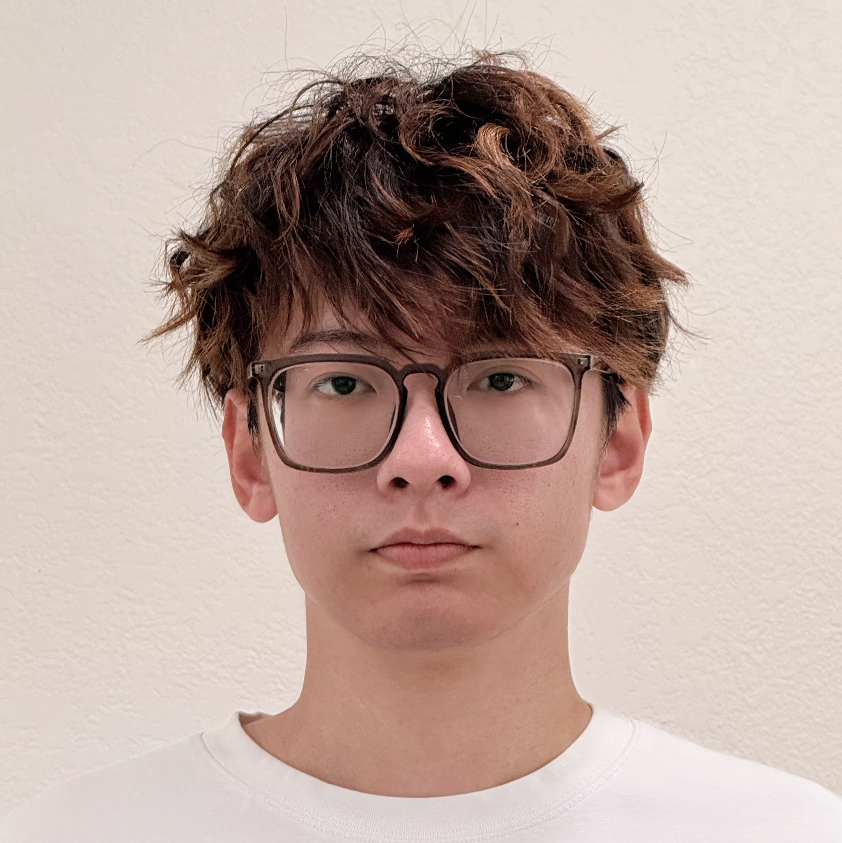
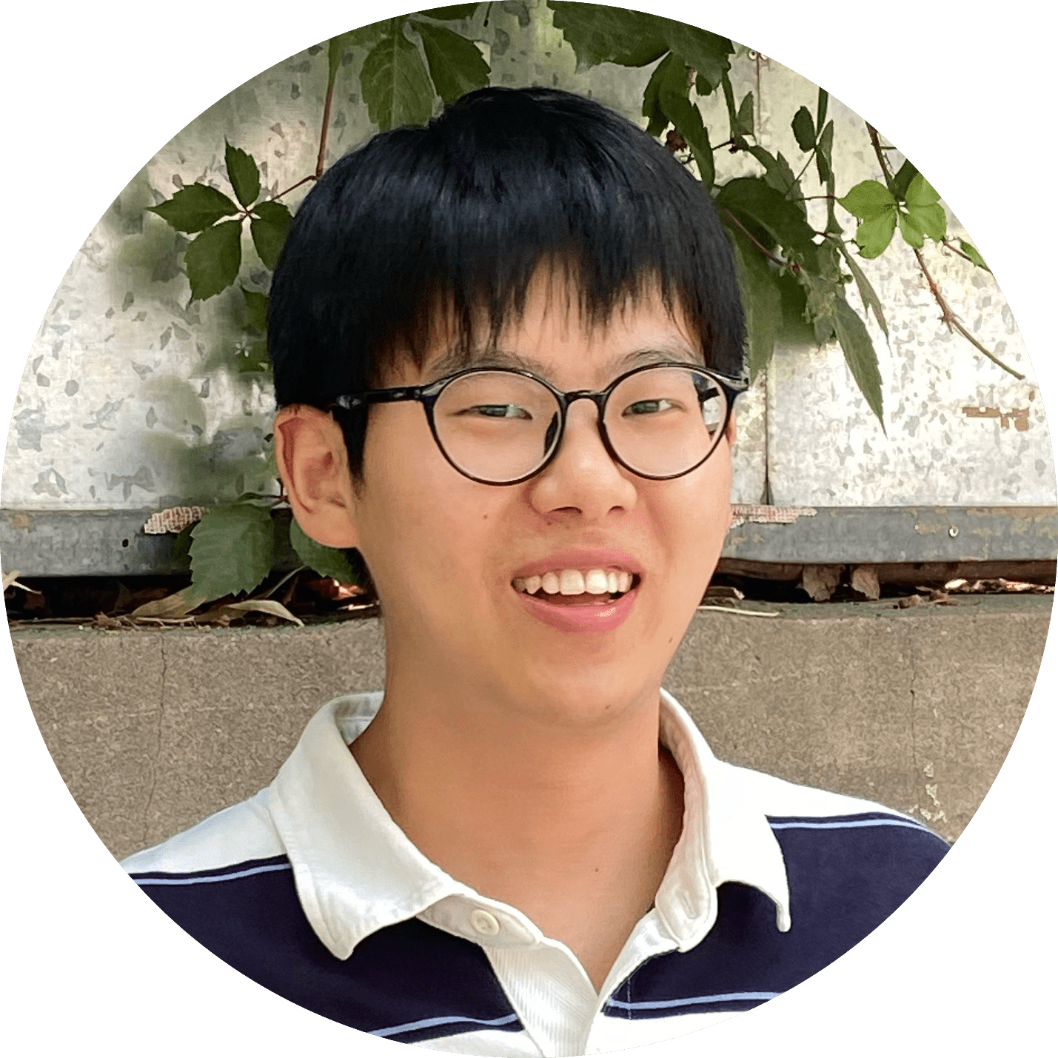
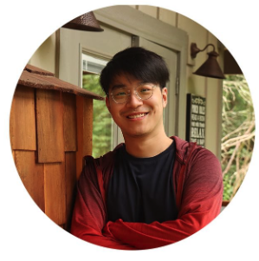
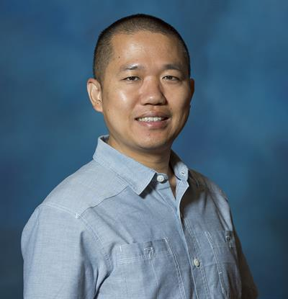



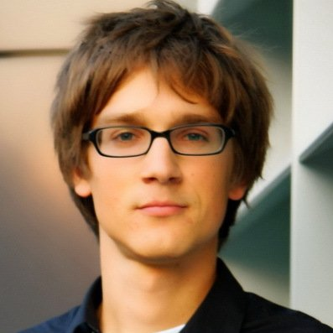
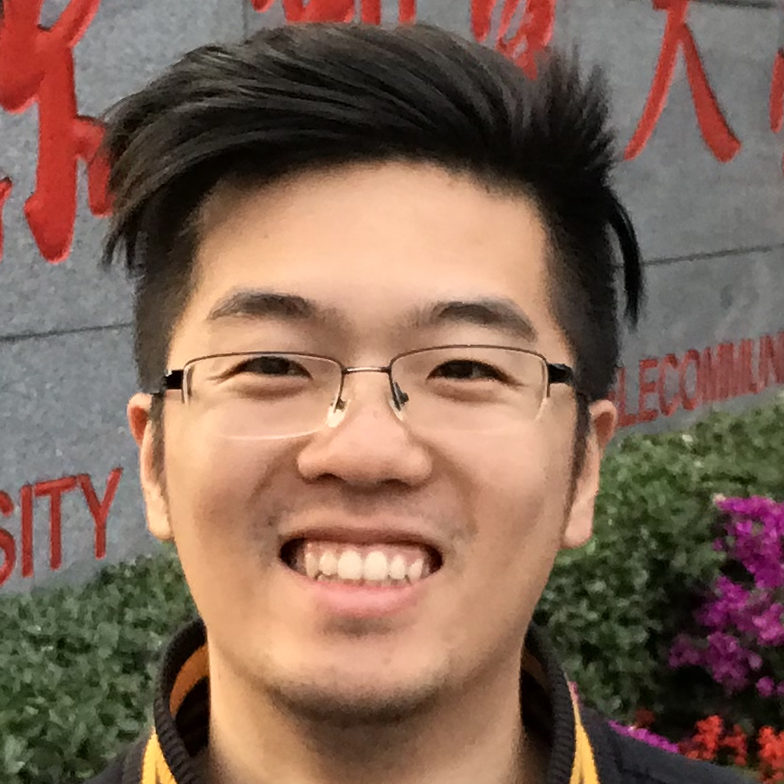
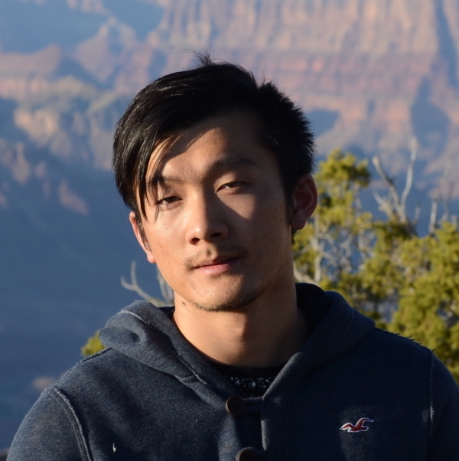



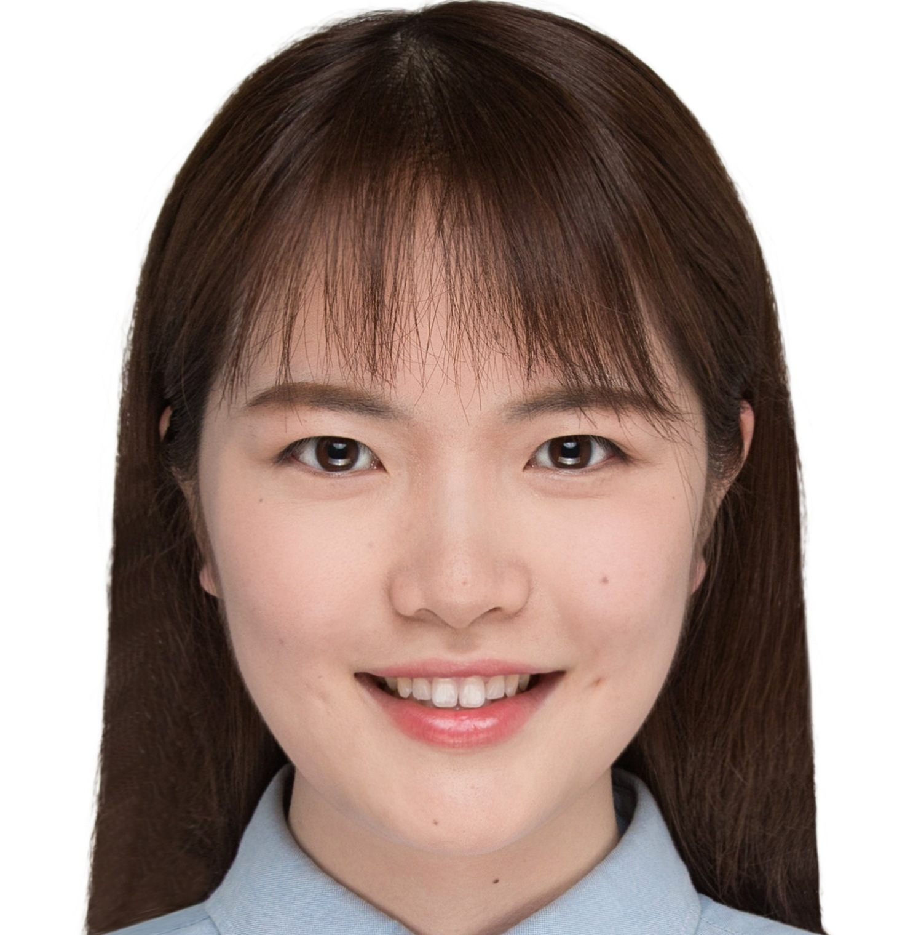


















Ack.
Emory Graph Mining Group

Slide 30

Thank you!
Emory Graph Mining Group
Questions & discussions
Welcome to collaborate!
j.carlyang@emory.edu
https://cs.emory.edu/~jyang71/

